Slide 1


PaNOSC AAI
Christos Kanellopoulos, GÉANT

Slide 2
UmbrellaID.org
Facts
Started out in 2012 as a collaboration between the main European analytical user facilities in the field of research using photons and neutrons (PaN facilities)
Over 1000 users providing services to 16 European organisation
Objectives
Provide a common Authentication and Authorization Infrastructure that allows users of all PaN facilities to connect seamlessly to digital facility services with a single and unique ID.
Authorization should remain in full control of each facility providing the services
Users should be in full control of their personal data

Slide 3
UmbrellaID.org | Goals in PaNOSC
Increase capacity to respond to users’ needs in a stable, secure and trusted environment
Cater from the growing security constraints and legal requirements
Global and comprehensive interoperability with services outside of the Photon and Neutron domain
Access to the European Open Science Cloud

Slide 4
Requirements 1/2
EOSC integration
Currently users can link their eduGAIN account with their umbrellaID account, allowing them to retain a single account. We need to go further and allow a complete interoperability with EOSC services in term of access, support and security.
Security policies
Policies regarding password changes, audit and user vetting must be introduced. Two factors of authentication should be proposed to the users. It is necessary to look at security issues at a global level and participate in international efforts
Attributes
We need to extend the set of attributes (e.g. email address) in a full compliance with the different regulations regarding personal data protection.

Slide 5
Requirements 2/2
Operation
The current operations of the IdPs are supported by a team of 2 engineers not solely dedicated to this task. We need to extend the support team in order to have a constant cover and surveillance of the services operations
Innovation
FIM and authentication technologies are constantly evolving; we would like to be at the forefront with these advancements. This would be easier to achieve in a context of a larger technical collaboration. Support for OIDC, REST APIs, non-web services
Training and Service Support
FIM technologies are still relatively complex and demand specific training and support, especially for the service providers’ engineers in order to enable the rapid growth of the number of services in a secure environment.

Slide 6

GÉANT eduTEAMS AAI as a Service for communities
A service to enable use of federated identities in research communities
Partner for any e-Infra or Research Infra inc. “long tail”, informal groups
Components
Membership Management service
Characteristics
Discovery Service
Full implementation AARC Blueprint Architecture
Single- and multi-tenant options
Second Factor Authentication (Pilot!)
Sustainability and strategic partnerships
Metadata Service
Proxy & Identity Hub

Slide 7
eduTEAMS
Users sign in to services with their community identity via eduTEAMS
Users register once and access any service (available to the their community)
Reduces complexity for Service Providers by providing one integration point for all services
Integration with GÉANT, EOSC(-hub) and other community and/or eduGAIN services

Slide 8

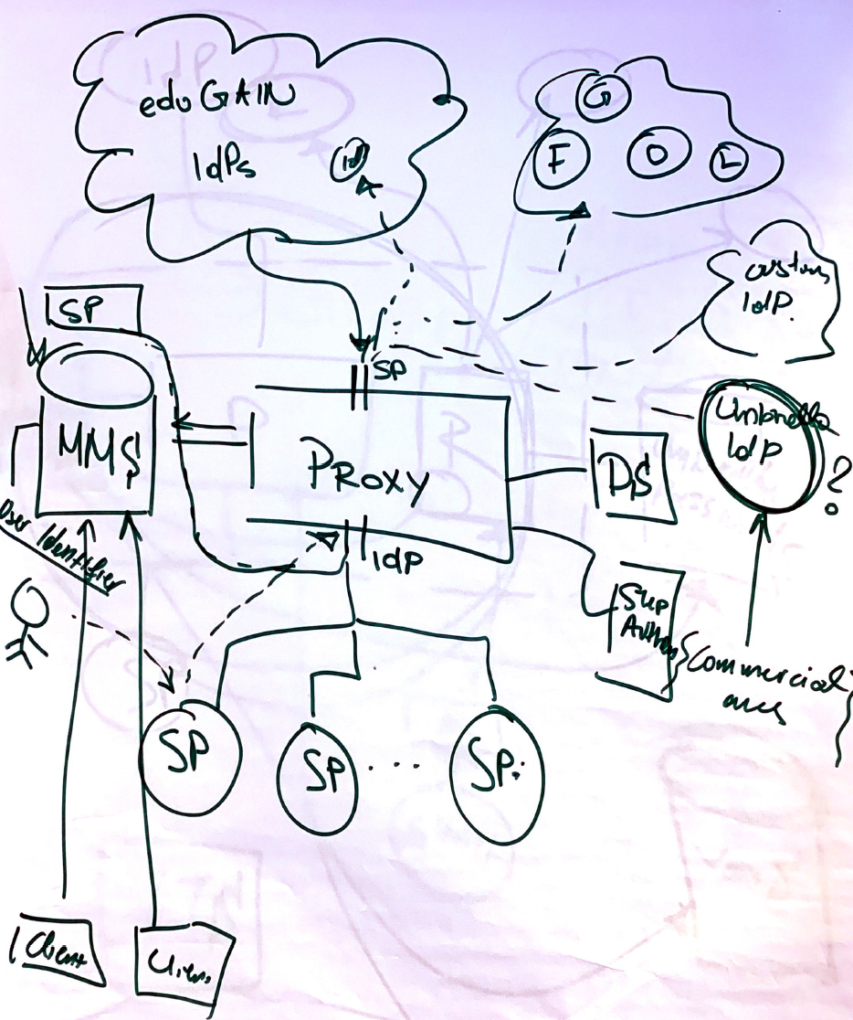
PaNOSC AAI
Users sign in to services with their community identity via eduTEAMS
Users register once and access any service (available to the their community)
Reduces complexity for Service Providers by providing one integration point for all services
Integration with GÉANT, EOSC(-hub) and other community and/or eduGAIN services

Slide 9
PaNOSC AAI
Proxy & Identity Hub
Single integration point for all SPs (with support for both SAML and OIDC)
Attribute aggregation from MMS
Central Policy Definition and Enforcement point
Support for OIDC Providers and non-eduGAIN SAML Identity Providers
Supports Research and Scholarship (R&S) Entity Category

Slide 10
PaNOSC AAI
Membership Management services
VO specific workflows for onboarding members
Registry for user persistent Identifiers
Support for R&S attributes to maximize interoperability
Use of eduPersonEntitlement(s) to express groups, roles and Service Entitlements
Choice between COmanage, HEXAA and Perun

Slide 11
PaNOSC AAI
Discovery Service
Emphasis on user friendliness (implements RA21 guidelines)
Integrates directly with the metadata service
Flexible import mechanism for SAML entities (eduGAIN and non-eduGAIN)
Metadata Service
Integrates directly with the eduTEAMS Proxy and the Discovery Service
Single point of trust for all (SAML) metadata

Slide 12
PaNOSC AAI
Umbrella IdP
Emphasis on user friendliness (implements RA21 guidelines)
Integrates directly with the metadata service
Flexible import mechanism for SAML entities (eduGAIN and non-eduGAIN)
Metadata Service
Integrates directly with the eduTEAMS Proxy and the Discovery Service
Single point of trust for all (SAML) metadata

Slide 13
PaNOSC AAI
Notes:
Full implementation of BPA –

Slide 14
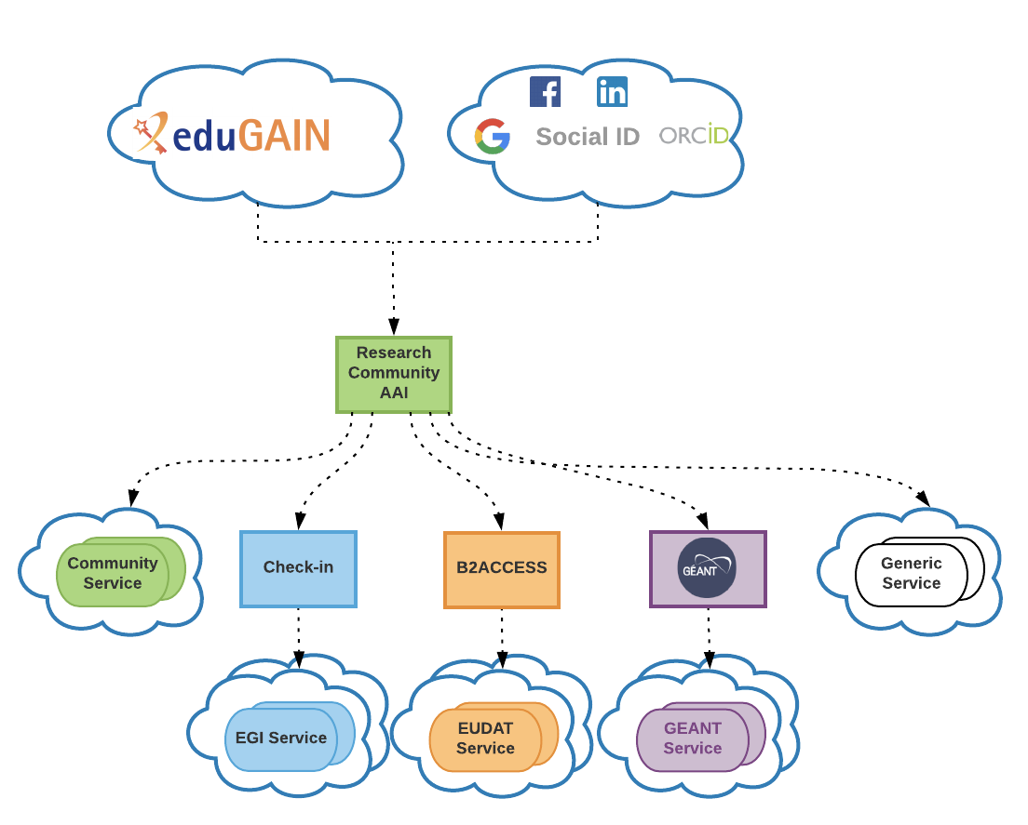
PaNOSC AAI

Slide 15
PaN Services
A self-service portal for creating personal accounts and facilitating the management of personal profile
User Office portal of the facilities. After linking their account with existing local accounts of the facilities, users can access user office portals and, for instance, submit experimental proposals
Facilities are increasingly providing internet access to their experimental data through online data catalogues. UmbrellaID users can directly benefits of such services
An emerging service is the access to workstation or compute resources for data analysis made possible through the Assent technology
Access to wayforlight portal wayforlight.eu
Access to PanData software catalogue for PaN facilities pandata.eu
At PSI umbrellaID.org is used to give network access to external companies through RADIUS.

Slide 16
PaN Services
A self-service portal for creating personal accounts and facilitating the management of personal profile
User Office portal of the facilities. After linking their account with existing local accounts of the facilities, users can access user office portals and, for instance, submit experimental proposals
Facilities are increasingly providing internet access to their experimental data through online data catalogues. UmbrellaID users can directly benefits of such services
An emerging service is the access to workstation or compute resources for data analysis made possible through the Assent technology
Access to wayforlight portal wayforlight.eu
At PSI umbrellaID.org is used to give network access to external companies through RADIUS.
Access to PanData software catalogue for PaN facilities pandata.eu

Slide 17

Thank you

